Slide 1
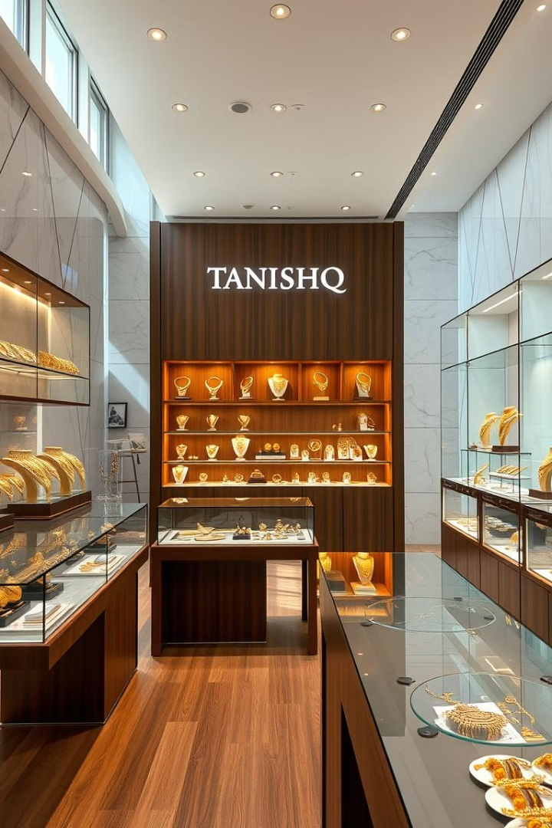
Tanishq: A Journey from Humble Beginnings to jewellery Powerhouse
Tanishq, a beloved Indian jewelry brand, embarked on its journey in 1994 . Initially, the company faced significant challenges but overcame them through strategic innovation and a customer-centric approach.
by Pandurang Rayfalwar

Slide 2
Overcoming Early Challenges
Tanishq faced significant cumulative losses exceeding 150 crores during its initial years.
The company's focus on quality and customer trust was essential in overcoming early challenges.
To build trust with customers, Tanishq implemented several initiatives:
A. Free gold purity checks to ensure transparency.
B. Use of advanced gold carat checking machines for quality assurance.
These efforts laid a strong foundation for the company's future growth.

Slide 3
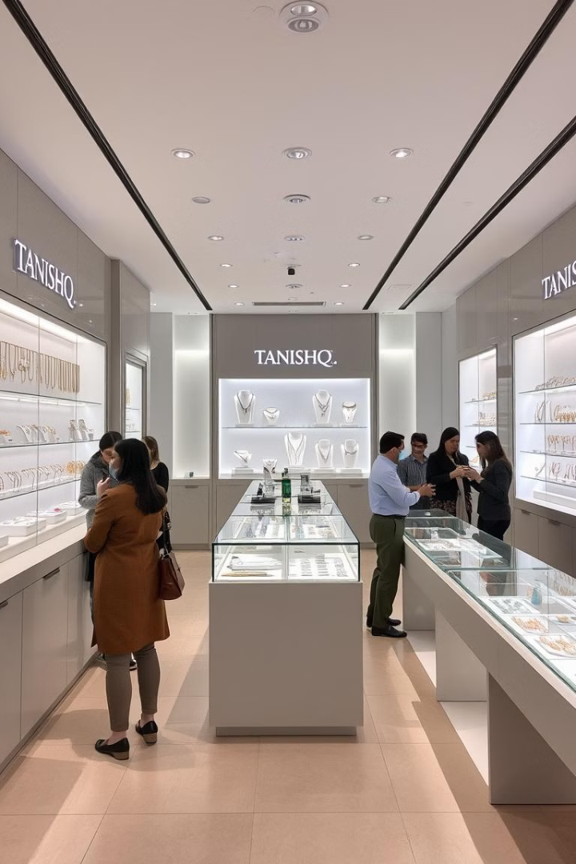
Building a Strong Retail Presence
Franchising Expansion
Flagship Stores
To expand its reach, Tanishq implemented a franchising model. This allowed them to rapidly establish a network of retail outlets across India, bringing their exquisite jewelry closer to customers.
Tanishq established impressive flagship stores in Chennai and Mumbai. The Chennai store spanned an expansive 20,000 sq. ft., while the Andheri, Mumbai store boasted a larger 25,000 sq. ft. space, showcasing their commitment to upscale retail experiences.

Slide 4

Catering to Diverse Customer Segments
MIA & ZOYA
RIVAAH: Celebrating Weddings
Tanishq launched brands like MIA and ZOYA, specifically designed for working-class women. These brands offered contemporary styles and affordable luxury, catering to the evolving needs of modern women.
Recognizing the significance of weddings in Indian culture, Tanishq introduced RIVAAH. This brand offers a curated collection of wedding jewelry that aligns with the diverse cultural traditions of brides across India, ensuring a beautiful and meaningful experience.

Slide 5



A Legacy of Growth & Innovation
Retail Presence
KARIGAR Parks
Today, Tanishq has a strong presence across India, with over 403 showrooms in 241 cities. The company boasts an impressive retail space exceeding 20 lakh sq. ft., demonstrating its commitment to providing a wide range of options and excellent customer service.
To enhance productivity, Tanishq established KARIGAR parks. These state-of-the-art facilities bring all machinery and resources together, allowing workers to work comfortably and efficiently. This has significantly boosted production capacity.

Slide 6

Transformative Impact on Productivity
550%
4kg
Production Capacity
Worker Productivity
Tanishq's KARIGAR parks have resulted in a remarkable 550% increase in production capacity. This demonstrates the power of optimizing the manufacturing process and investing in skilled labor.
Previously, each worker could only finish 750gms of gold per day. However, with the improved facilities and streamlined workflow, worker productivity has increased to 4kg per day, reflecting a significant improvement.

Slide 7
The Tangible Benefits of KARIGAR Parks
Reduced Wastage
1
By consolidating resources and streamlining the process, Tanishq achieved a remarkable reduction in gold wastage, dropping from 5% to a mere 0.15%. This demonstrates the company's commitment to sustainability and efficient resource management.
Time Optimization
The KARIGAR parks also significantly reduced time consumption in the production process. This allows Tanishq to meet growing demands more effectively and ensure timely delivery to customers.
2

Slide 8

A Legacy of Success and Innovation
Tanishq's story is an inspiring testament to the power of innovation, customer focus, and strategic planning. From humble beginnings to becoming a leading player in the Indian jewelry market, Tanishq's journey is a blueprint for aspiring entrepreneurs and a source of pride for the Indian business landscape.

Slide 9
Thank You…
Pandurang Rayfalwar
pandurangrayfalwar@gmail.com

